Slide 1
Welcome to Section!!!
Week One

Slide 2
Congratulations

Slide 3
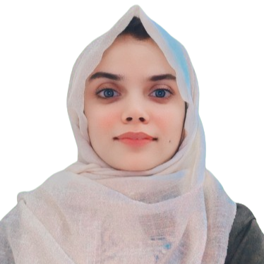
A Little About Me
My name is Mah Noor Fatima. I’ll be your Section Leader for Code in Place, and everyone here will be your mates!
I am working in Software Engineering.
In my free time I like to Read Books.
I enjoy Music & Coffee.

Slide 4
What About You All?
Go ahead and share:
Your name
Where you’re turning in from
One thing you’re looking forward to (it doesn’t have to be from Code in Place)!

Slide 5
Breaking the Ice
🔨
🧊
In breakout rooms:
Share your names one more time!!!
Icebreaker Question: What’s your dream project?
If no one wants to share first, the person who is geographically closest to Stanford shares first!
Notes:
END 7:15

Slide 6
Lecture Review

Slide 7

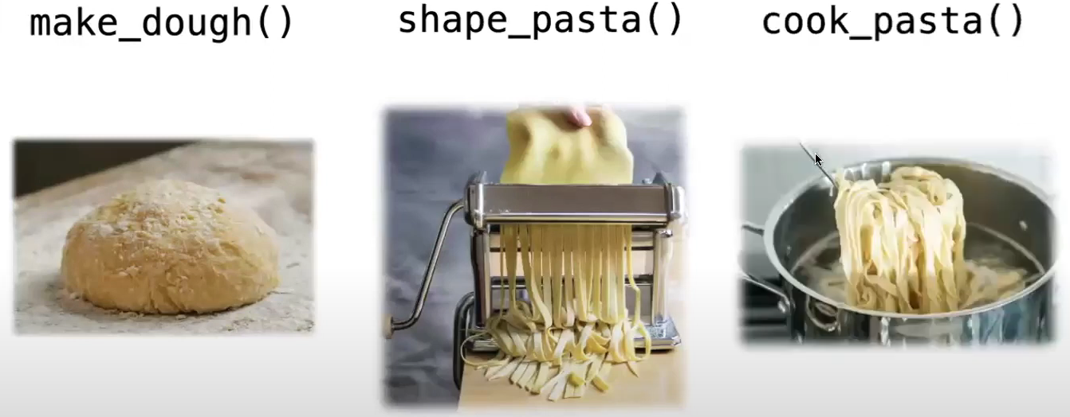
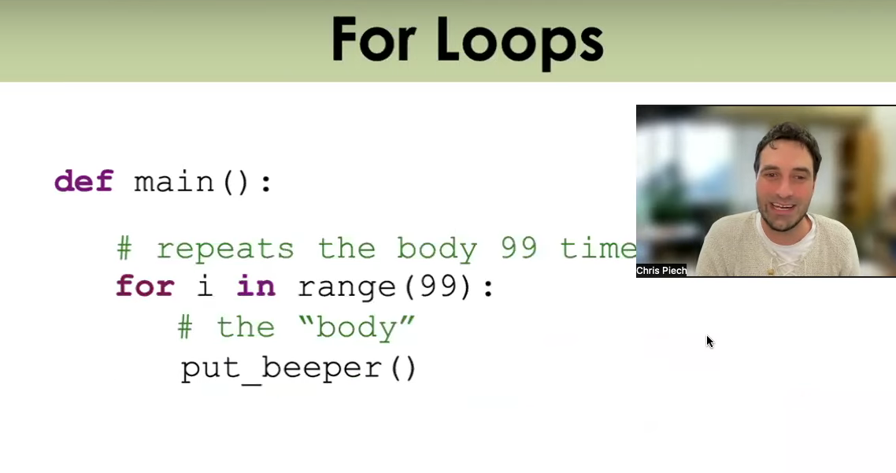
What We’ve Learned
Before we get into our sample problem for today, let’s review a bit. We’ve learned:
The basics about Karel, the magnificent and wonderful robot
Functions, a way of breaking down big problems into smaller chunks
Control Flow, loops and conditional statements which guide our programs
This is a LOT of content, especially if you are newer to CS!

Slide 8
Let’s review and refresh these concepts a bit!

Slide 9
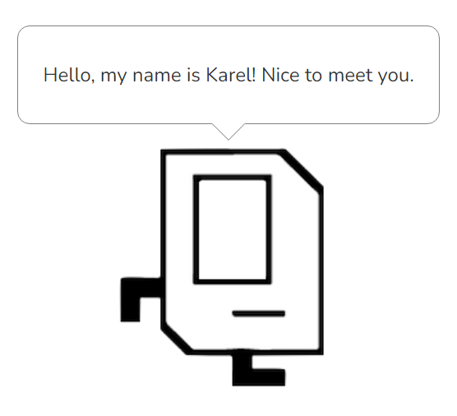
Karel Overview
Karel is a small, but mighty robot!!!
It has a few basic commands including: move(), turn_left(), pick_beeper(), and put_beeper()
On its own, Karel has limited functionality, but with the help of our code, we can make great things happen!

Slide 10
Functions Overview
When you think of functions, recall Chris and Mehran’s analogy to making pasta. Each function has a specific purpose which breaks down a larger problem into smaller chunks—just like steps in making pasta from scratch!
To make a function, you need to define it using the def keyword. Afterwords, write the code you want the function to run. Make sure the code is indented below the function name like so:
def function_name():
# Function code goes here!!!

Slide 11
Control flow
if
if/else
for
while

Slide 12
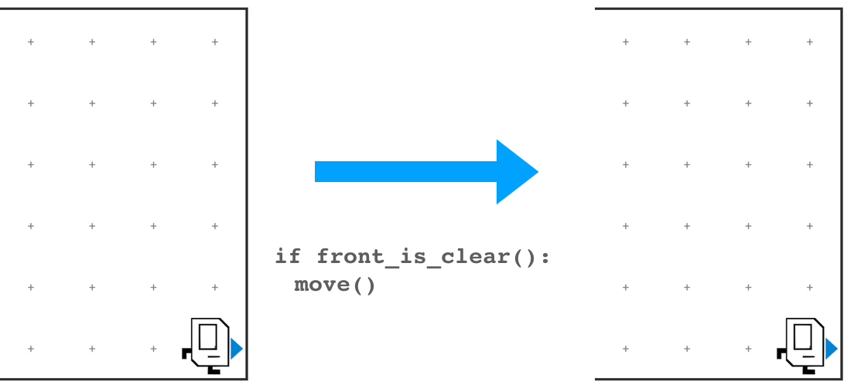
Control flow
Do something when a condition is met.
if
if/else
for
while

Slide 13
Control flow
if
if/else
for
while

Slide 14
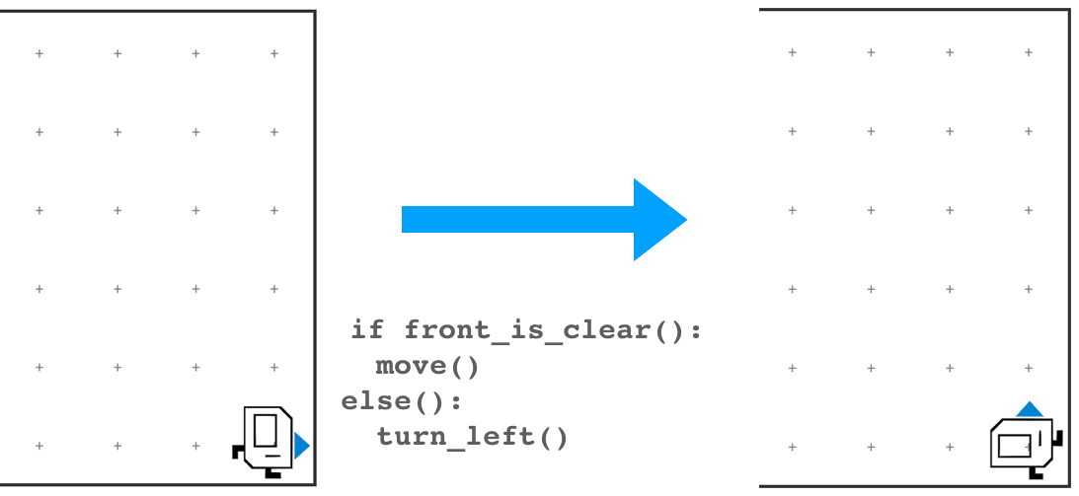
Control flow
if
Also do something else when a condition is not met.
if/else
for
while

Slide 15
Control flow
if
if/else
for
while

Slide 16
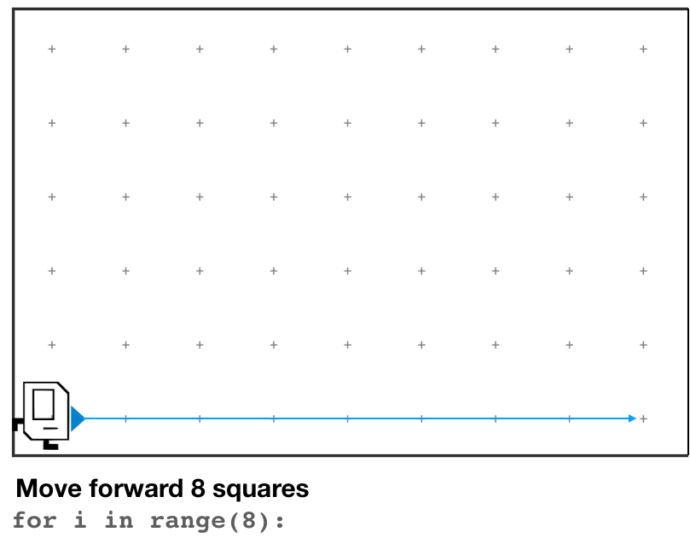
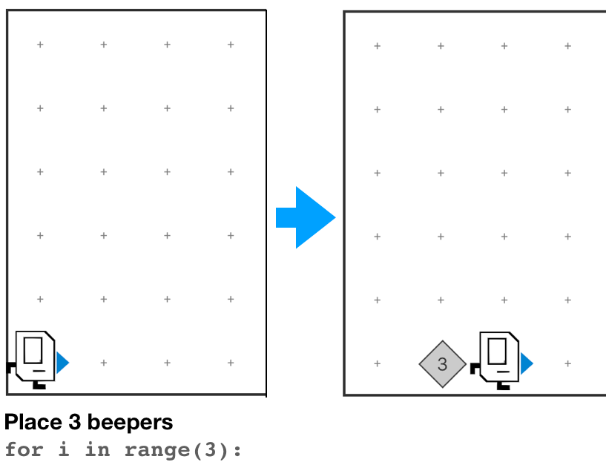
Control flow
if
if/else
for
Do something a set number of times.
while

Slide 17
Control flow
if
if/else
for
while

Slide 18
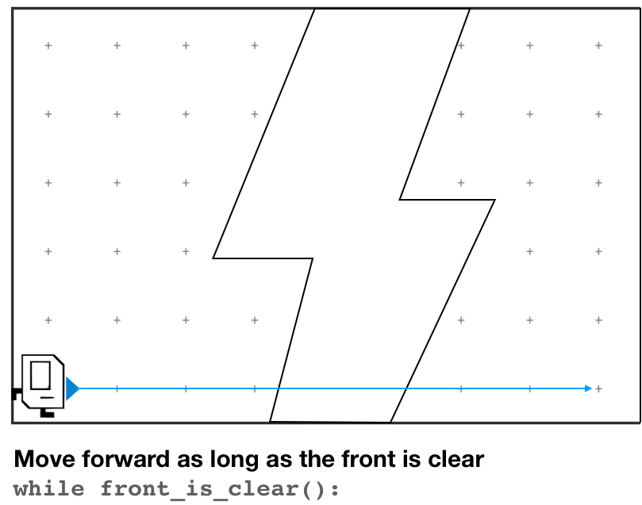
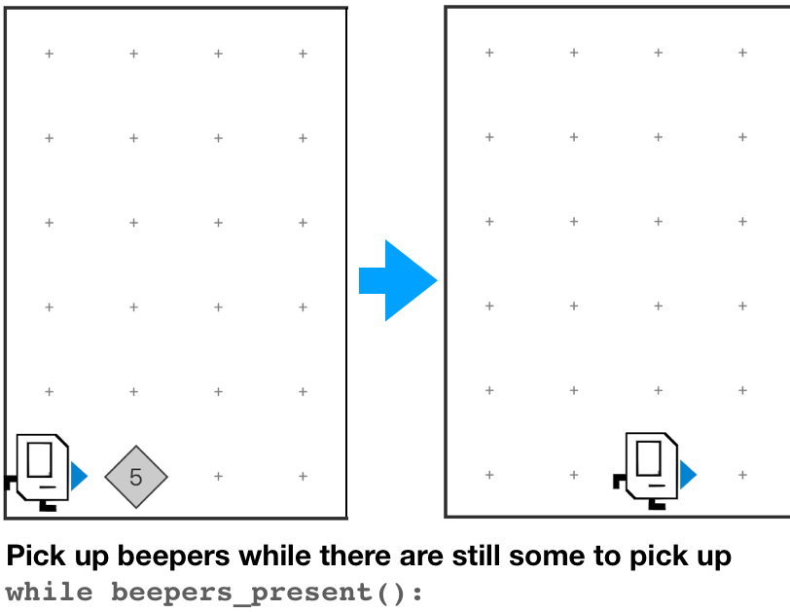
Control flow
if
if/else
for
Do something until condition is no longer true.
while

Slide 19
Control flow
No
if
Do you have a backup plan?
Yes
if/else
yes
Is it a one-off?
for
yes
Do you know how many times you need to do it?
No
while
no

Slide 20
Decomposition

Slide 21
Decomposition
Define your function like this:
def function_name():
<write code here>
And call it like this:
function_name()

Slide 22
Decomposition

Slide 23
Decomposition
More of an art than a science.
Functions should be short and read like English.
If you repeat things (or find yourself hitting copy/paste), take a step back.
Top-down programming & the leap of faith.

Slide 24
Decomposition

Slide 25
Decomposition
def main():
turn_left()
turn_left()
turn_left()
turn_left()
turn_left()
turn_left()
turn_left()
turn_left()
turn_left()
turn_left()
turn_left()
turn_left()

Slide 26
Decomposition

Slide 27
Decomposition
def main():
turn_left()
turn_left()
turn_left()
turn_left()
turn_left()
turn_left()
turn_left()
turn_left()
turn_left()
turn_left()
turn_left()
turn_left()
def main():
spin()
spin()
spin()
def spin():
turn_left()
turn_left()
turn_left()
turn_left()
Notes:
Does this code do the same thing?
Is this code easier to read/understand?
Is this code easier to write?

Slide 28
Any Questions?

Slide 29
Section Problem: Hospital Karel

Slide 30
Setting Context
Countries around the world are dispatching hospital-building robots to make sure anyone who gets sick can be treated. They have decided to enlist Karel robots. Your job is to program those robots.

Slide 31
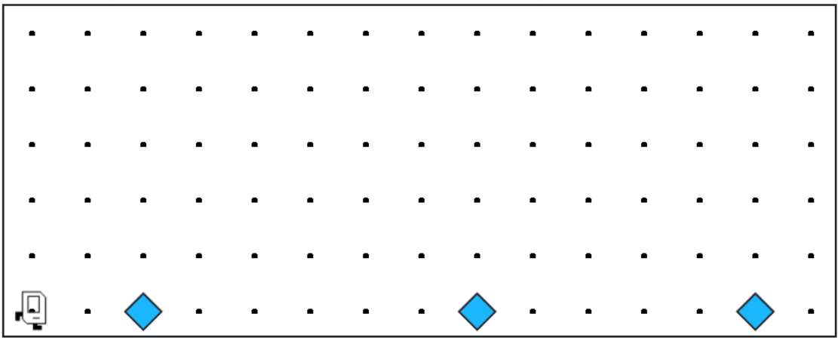
Each beeper in the figure represents a pile of supplies.

Slide 32
Karel’s job is to walk along the row and build a new hospital in the places marked by each beeper.

Slide 33
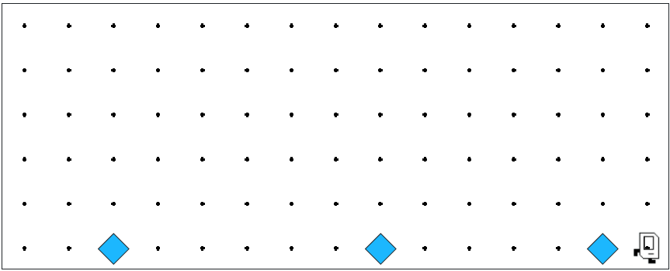

Karel’s job is to walk along the row and build a new hospital in the places marked by each beeper.

Slide 34

Hospitals look like this: a 3x2 rectangle of beepers!

Slide 35
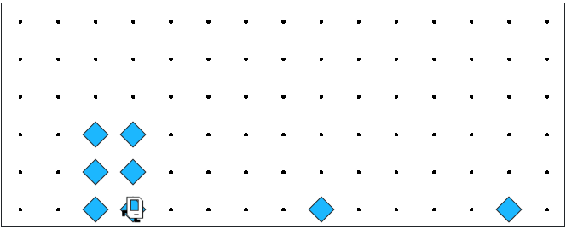
The new hospital should have their corner at the point at which the pile of supplies was left.

Slide 36
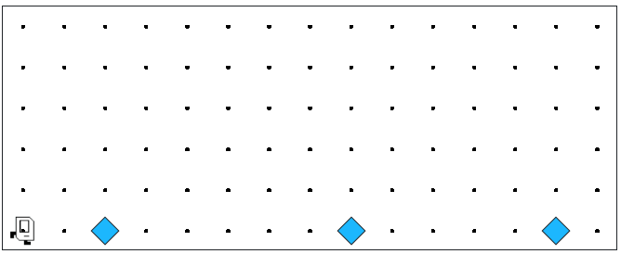
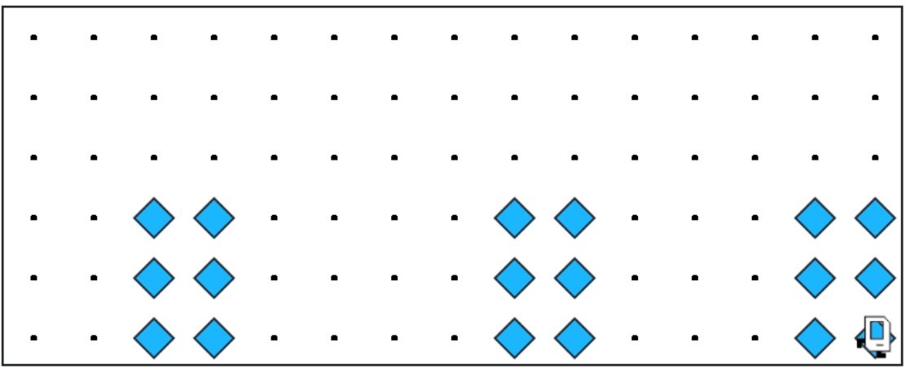
At the end of the run, Karel should be at the end of the row having created a set of hospitals. For the initial conditions shown, the result would look like this:

Slide 37
Notes to Keep in Mind
🗒️
✏️
Karel starts facing east at (1, 1) with an infinite number of beepers in its beeper bag.
The beepers indicating the positions at which hospitals should be built will be spaced so that there is room to build the hospitals without overlapping or hitting walls.
There will be no supplies left on the last column.
Karel should not run into a wall if it builds a hospital that extends into that final corner.

Slide 38
Questions Before We Begin?

Slide 39
Let’s get to work!

